Slide 1
Software development basics

Slide 2
Topics
Programming and programming languages.
Pseudocode and flowcharts.
Variables
Datatypes
Operators
Conditionals
Loops
Lists
Functions

Slide 3
Chapter Objectives
Define a programming and programming languages.
Differentiate between programming and coding.
Define a pseudocode and a flowchart.
Write a pseudocode and draw a flowchart for a specific problem.
Define the variables, operators and datatypes.
Use the loop and conditional control flow.
Use list and functions.

Slide 4
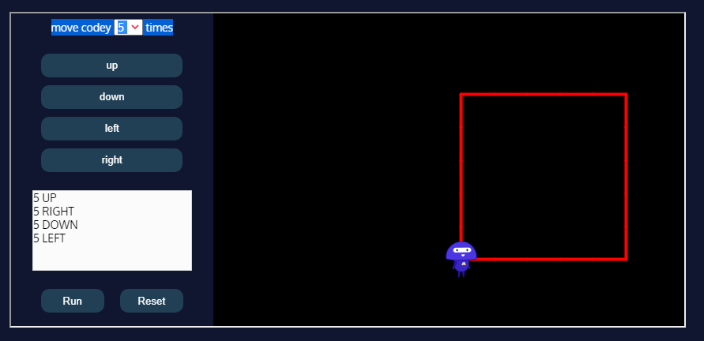
What is Programming?
Programming is giving a set of instructions to a computer to execute.

Slide 5
Programming apps
Build a mobile app
Search a database
Program a robot

Slide 6
Programming vs Coding
While sometimes used interchangeably, programming and coding actually have different definitions.
Programming is the mental process of thinking up instructions to give to a machine (like a computer).
Coding is the process of transforming those ideas into a written language that a computer can understand.

Slide 7
Programming
All Programs Have in Common:
Take data and manipulate it to produce a result
Input – Process – Output
Input: from files, the keyboard, or other input device
Process: perform some operations on the input to get the required result.
Output: display or print the result using the monitor, printer, or other output device.

Slide 8
Programming languages
Programming languages is a system of notation for writing computer programs. They are used to best communicate with computers.
Programming languages are either text-based or graphical.
Programming has evolved from punch cards with rows of numbers that a machine read, to drag-and-drop interfaces that increase programming speed.

Slide 9
Punch cards

Slide 10
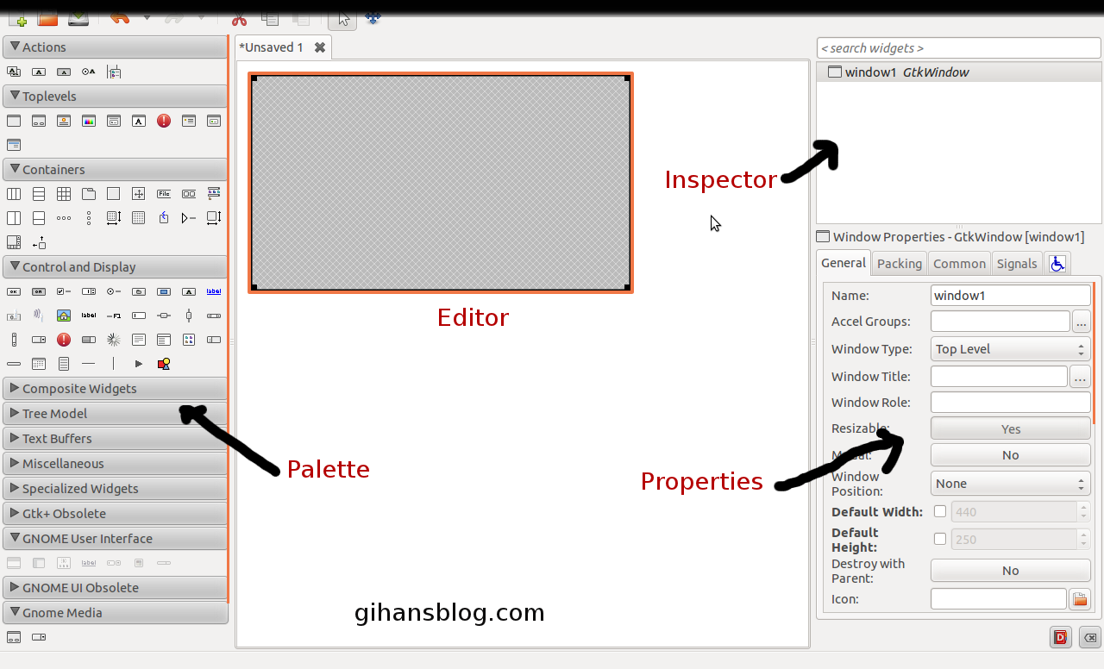
Drag-and-drop interfaces

Slide 11
Programming Languages
Machine language
“Natural language” of computer component
Machine dependent
Assembly language
English-like abbreviations represent computer operations
Translator programs convert to machine language
High-level language
Allows for writing more “English-like” instructions
Contains commonly used mathematical operations

Slide 12
Translators
Compiler
Converts high-level language programs to machine language
Example: C, C++, C#
Interpreter
Execute high-level language programs without compilation
Example: Perl, Python and Matlab
Assembler
Converts Assembly language programs to machine language
Example: GAS

Slide 13
How do we solve a problem using a computer?
Problem
Software Design:
choose algorithms and data structures
Algorithm
Programming:
use language to express design
Program
Compiling/Interpreting:
convert language to machine instructions
Instruction
Set

Slide 14
Problem Solving
Problem Statement
stated using "natural language"
may be ambiguous, imprecise
Algorithm
step-by-step procedure, guaranteed to finish
definiteness, effective computability, finiteness
Program
A program is a collection of instructions.
express the algorithm using a computer language
high-level language, low-level language

Slide 15
Problem Solving
A program solves a problem by:
Taking in data
Manipulating the data
Producing some information
If you can break a problem down into these steps, you can create a program to solve it.
But do we start writing code as soon as we run into a problem? Answer: No !

Slide 16
Program Development Cycle
When Developing a program in the real world, there are seven steps:
Analyze the problem
Plan a solution
Design an interface
Write the code
Test and debug
Document the program
Maintain the program

Slide 17
Analyze the Problem
Understand what the problem is and what the solution should be
Keep in mind what the End User should be able to see and do.
User – Anyone who uses the program.
End User – The person whom the program was designed for him/her to use.
Also keep in mind what the CORRECT solution to the problem is.
This needs to be done before ANY of the following steps can take place.

Slide 18
Algorithms vs. Programs
An Algorithm is a step-by-step procedure devised for the purpose of taking in data and producing the correct output.
A program is the actual implementation of an algorithm in a programming language.
Before writing a program, you must develop an algorithm to solve a problem.
It is highly recommended to think about the problem first, then develop an algorithm, then write the program.

Slide 19
Plan a Solution
Once you understand the problem, you can develop an algorithm.
Create precise steps for the entire flow of the program. Usually in the form of:
Get Input
Validate Input
Manipulate Input
Output Solution
Every detail should be covered in the algorithm.
Consider what is logical and illogical for the control flow.
There are many tools programmers use to model the flow of a program.

Slide 20
Modeling Tools
To help understand the steps of an algorithm, programmers use a variety of tools:
Pseudocode
is a description of an algorithm using everyday wording, but molded to appear similar to a simplified programming language.
Flowchart
is a type of diagram that represents a workflow or process. A flowchart can also be defined as a diagrammatic representation of an algorithm, a step-by-step approach to solving a task.

Slide 21
Flowchart symbols
Terminal: is an oval that indicates the beginning and end of a program. It usually contains the words Start or End.
Flowline: is a line from one symbol pointing towards another to show the process’s order of operation. This displays the flow of execution in a program.

Slide 22
Flowchart symbols
Input/Output: input/output is represented by a rhomboid and indicates the input or output of data. This is similar to setting a value to a variable.
Process: represented by a rectangle, is an operation that manipulates data.

Slide 23
Flowchart symbols
Decision: represented by a rhombus and show a conditional operation that will determine which path a program should take. This is similar to conditional statements which control the flow of execution in a program.
Connector: Used to join flow lines.

Slide 24
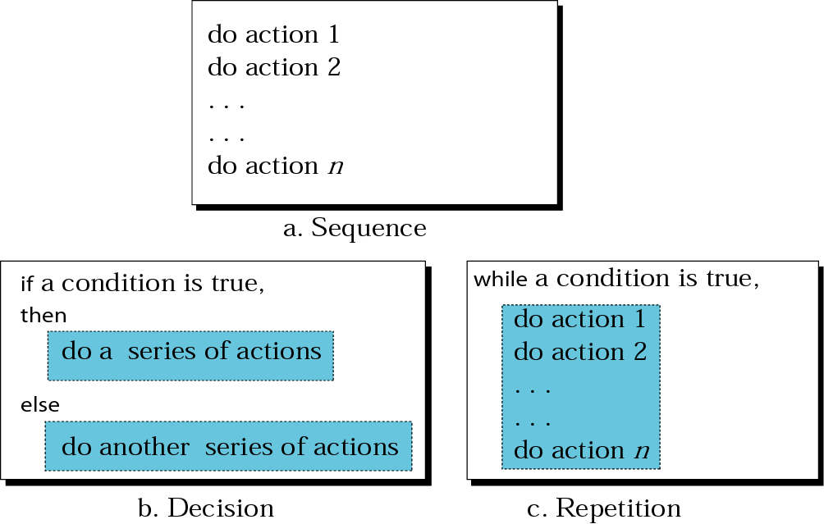
Three Basic Constructs

Slide 25
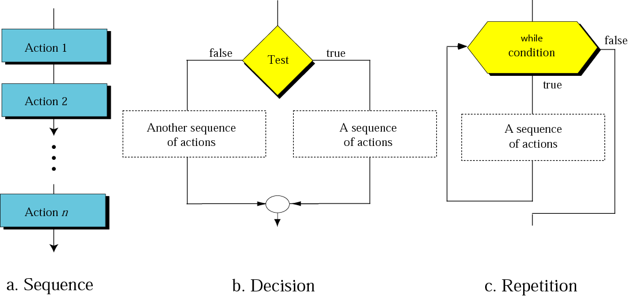
Flowcharts for three constructs

Slide 26
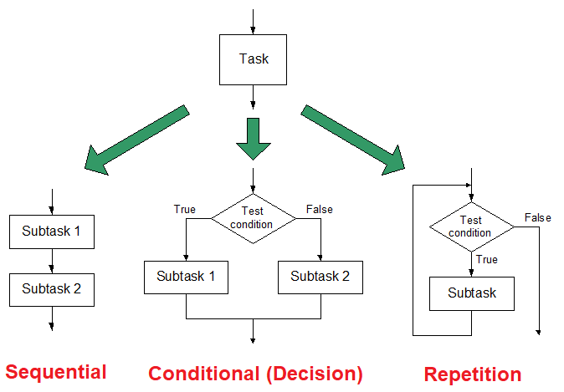
Three Basic Constructs
There are three basic ways to decompose a task:

Slide 27
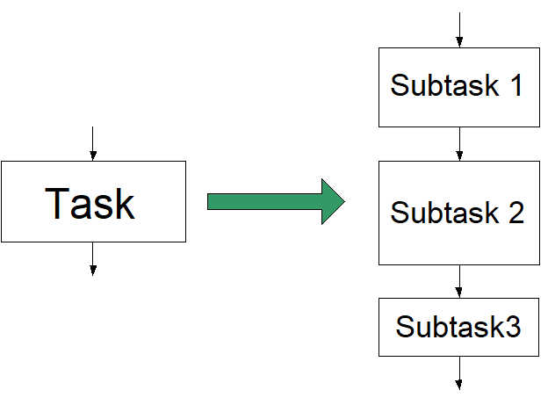
Sequential
Do Subtask 1 to completion, then do Subtask 2 to completion, etc

Slide 28
Sequential
Example 1: Write an algorithm and draw a flowchart to convert the length in feet to centimeter.
Length in cm= length in feet * 30.48

Slide 29
Sequential
Example 1:
Pseudocode:
Input the length in feet (Lft)
Calculate the length in cm (Lcm) by multiplying LFT with 30.48
Print length in cm (LCM)
Algorithm:
Step 1: Input Lft
Step 2: Lcm ← Lft x 30.48
Step 3: Print Lcm

Slide 30
Sequential
Example 1:
Flowchart:
Start
Input
Lft
Lcm ← Lft x 30.48
Print
Lcm
End

Slide 31
Sequential
Example2: Write an algorithm and draw a flowchart that will read the two sides of a rectangle and calculate its area.
Rectangle area = length * width

Slide 32
Sequential
Example 2:
Pseudocode:
Input the width (W) and Length (L) of a rectangle
Calculate the area (A) by multiplying L with W
Print A
Algorithm:
Step 1: Input W,L
Step 2: A = L * W
Step 3: Print A

Slide 33
Sequential
Example 2:
Flowchart:
Start
Input
W, L
A ← L x W
Print A
End

Slide 34
Sequential
Example 3: Consider the problem of finding out how many stamps you need to put on an envelope to mail it.
The rule here is that you need 1 stamp for every 5 sheets of paper in the envelope.
So, the algorithm looks something like this:
Get the number of sheets from the user. (Input)
Divide the number of sheets by 5 (Process)
Round the result from step 2 the highest whole number (Process)
Output the number of stamps (Output)

Slide 35
Sequential
Example 3:
So, a specific example looks like
The user inputs 16 sheets of paper
Dividing 16 by 5 results in 3.2
Rounding 3.2 up results in 4
Output 4 stamps

Slide 36
Sequential
Example 3:
Flowchart:
Start
Read sheets
Set stamps = sheets / 5
Round stamps up to next whole number
Display: "You will need: " stamps
End

Slide 37
Sequential
Example 3:
What could go wrong?
What if the user inputs “Banana” sheets of paper?

Slide 38
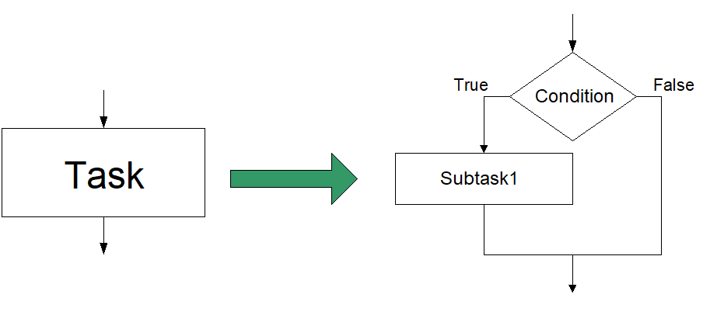
Conditional/ Decision
If condition is true, do Subtask 1; else, do Subtask 2.

Slide 39
Conditional/ Decision
The expression A>B is a logical expression.
it describes a condition we want to test.
if A>B is true (if A is greater than B) we take the action on left.
print the value of A
if A>B is false (if A is not greater than B) we take the action on right
print the value of B
A>B
Yes
No
Print A
Print B

Slide 40
If–then–else Structure
The structure is as follows:
If condition then
true alternative
else
false alternative
endif

Slide 41
If–then–else Structure
The algorithm for the flowchart is as follows:
If A>B then
Print A
else
Print B
endif
A>B
Yes
No
Print A
Print B

Slide 42
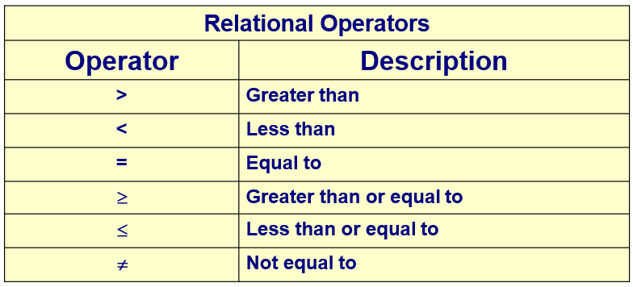
Relational Operators

Slide 43
Conditional/ Decision
Example 3: Stamp problem (Revised Algorithm)
Get the number of sheets from the user. (Input)
Check to see if the input is a positive number. (Validate)
Divide the number of sheets by 5 (Process)
Round the result from step 2 to the highest whole number (Process)
Output the number of stamps (Output)

Slide 44
Conditional/ Decision
Start
Read sheets
Is sheets positive number?
Yes
No
Set stamps = sheets / 5
Display error message
Round stamps up to next whole number
Display: "You will need: " stamps
End

Slide 45
Conditional/ Decision
Example 4: Create an algorithm and a flowchart that will read two numbers and then display the bigger number.

Slide 46
Conditional/ Decision
Example 4:
Algorithm:
1. Input number1, number2
2. If (number1 > number2) then
MAX = number1
Else
MAX = number2
Endif
3. Print “The largest value is”, MAX

Slide 47
Conditional/ Decision
Example 4:
Flowchart:
Start
Input
number1, number2
number1>number2
Yes
No
MAX number1
MAX number2
Print
“The largest value is”, MAX
End

Slide 48
Conditional/ Decision
Example 5: Create an algorithm and a flowchart that will accept a student mark and then display “PASS” if the mark is 50 or more and display “FAIL” otherwise.

Slide 49
Conditional/ Decision
Example 5:
Algorithm:
1. Input mark
2. If (mark >= 50) then
Print “PASS”
Else
Print “FAIL”
Endif

Slide 50
Conditional/ Decision
Example 5:
Flowchart:
Start
Input mark
mark >= 50
Yes
No
Print “PASS”
Print “FAIL”
End

Slide 51
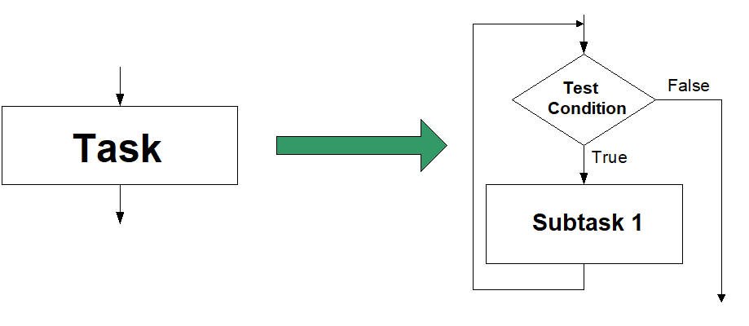
Repetition
Do Subtask over and over, as long as the test condition is true.

Slide 52
Repetition
Example 6: Write an algorithm and draw a flowchart to find the sum of numbers from 1 to 10.
1+2+3+4+5+6+7+8+9+10

Slide 53
Repetition
Example 6:
Algorithm:
Step 1: Set sum to 0, number to 1
Step 2: Repeat steps 3 and 4 until number = 10
Step 3: update sum as sum = sum + number
Step 4: increment number
Step 5: Print sum

Slide 54
Repetition
Example 6:
Flowchart:
Start
Set sum = 0
Set number = 1
number <= 10
No
Yes
sum = sum + number
number = number + 1
Print sum

Slide 55
Variables
Variable is a way of storing values in programming with a specific name so that they can be reused or changed throughout the program.
For example:
The above example shows a variable numberOfApples set to a value of 12.

Slide 56
Data types
Data is a basic unit in programming. Without data, we couldn’t write any programs! But what is data?
We may be familiar with data as information, or facts.
In computing, data is the pieces of information that we use to build programs, like the numbers in a calculation, or the text printed to a screen.
Data types tell us about the data, including how it can be stored and what types of operations we can perform.
For example, we can write a program that squares numbers, but it wouldn’t be able to square a word.

Slide 57
Data types
Primitives are the most basic data types. They include:
Numbers
Strings - any sequence of characters such as "Hello!"
Booleans - a True or False value
Computers can do different things with different kinds of data. This computer will process data according to the function that you give it. If the function matches the data type, you will get an answer! If it doesn’t, you’ll see an error.
The functions do the following:
capitalize: will turn lowercase characters into uppercase characters
square: will square a number
evaluate: will determine if an input is true or false

Slide 58
Operators
Operators
are different symbols that represent an operation, such as the plus sign (+) as a symbol for addition.
Operations enable us to process our data, to transform it into something else.
There are different ways we can use operators in programming.
Arithmetic operators
Comparison operators
Logical operators

Slide 59
Arithmetic Operators
Arithmetic
Addition (+)
Subtraction (-)
Multiplication (*)
Division (/)

Slide 60
Comparison operators
Comparison
Less than <
Greater than >
Equal ==

Slide 61
Logical operators
Logical
And
Or
Not

Slide 62
Loops and conditionals
A program is a set of instructions, executed in a certain order. This order, called control flow.
A loop is a block of instructions that is executed repeatedly for a specified number of times.
“if X, then do instruction set 1. Otherwise do instruction set 2.” This structure is called a conditional control structure.
All the instructions are shown in the diagram, but only some of them will be executed each time.
Conditional control structures, or just conditionals, allow programs to do different things in different scenarios.

Slide 63
List
Data structures are formats that we can use to keep track of our data in an organized fashion.
Lists are one very basic data structure.
Lists are used as containers to store multiple pieces of information that relate to each other in some way.
Examples: a list of the presidents of the US, types of cheeses in alphabetical order, and the finishing positions of runners in a race.
Lists are useful because we can add, remove, search through, and access values within them.
Lists order data in a specific, linear sequence. The position of value in a list is known as its index. An index like an address.
Usually, lists will start their index at 0 and then add one for each value.

Slide 64
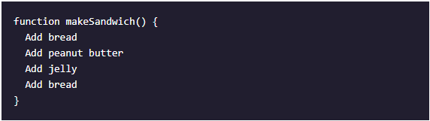
Functions
A program for creating a sandwich consists of four instructions:
add bread, add peanut butter, add jelly, and then add another bread on top.
But imagine needing to write enough code for 1000 sandwiches? That requires us to write a lot more code over and over again. Luckily, we can use functions to make this process easier!
A function is a named sequence of instructions, packaged as a unit, that performs a specific task.
Functions make code flexible, reusable, and well-organized. Let’s take a look at a sample.
makeSandwich() function will execute all the instructions inside of it anytime it is called in a program.

Slide 65
Functions
makeSandwich() function will execute all the instructions inside of it anytime it is called in a program.

Slide 66
Functions
However, no store only sells peanut butter and jelly sandwiches - our program needs to be able to make all kinds of sandwiches. Instead of writing a different function for each type of sandwich, we can have one function that can make them all!

Slide 67
Functions
We’ve updated our function makeSandwich() by giving it two inputs, or parameters.
Parameters are variables that can be used inside the function body. Each time we call the function, we’ll give actual values for each parameter, called arguments.
For example, we make a meet-and-cheese sandwich with makeSandwich(“meet", "cheese"). We call the function with the arguments “meet” and “cheese”. Those will be the values for the topping1 and topping2 parameters.

Slide 68
Wrapping up
Pseudocode is a description of an algorithm using everyday wording, but molded to appear similar to a simplified programming language.
In code-based flowcharts, common ANSI shapes are ovals for terminals, arrows for flowlines, rhomboids for inputs and outputs, rhombuses for decisions, and rectangles for processes.
Variables are named pieces of data. We can create and update the value attached to a variable.
Operators allow us to process and transform data. There are different kinds of operators like arithmetic operators, conditional operators, and comparison operators.

Slide 69
Wrapping up
Data types are used to specify various kinds of data, such as numbers, strings, or Booleans.
Conditionals use true or false expressions to determine whether a block of code is executed or not.
A loop is a block of instructions that is executed repeatedly for a specified number of times.
A list is a data structure that stores multiple pieces of data.
A function is a reusable block of code that can be called multiple times in a single program.

